Slide 1

Packages

Slide 2
Agenda
After this session, you will know
Naming Conventions in Packages
Creating Package
Importing all Classes in Package

Slide 3
Packages
What is Java Package?
Packages are containers for classes that are used to keep the class name space compartmentalized.
01
For example, a package allows you to create a class named List, which you can store in your own package without concern that it will collide with some other class named List stored elsewhere.
02
Packages are stored in a hierarchical manner and are explicitly imported into new class definitions.
03

Slide 4
Packages
Defining a Package
Include a package command as the first statement in a Java source file
Classes declared within that file will belong to the specified package.
The package statement defines a name space in which classes are stored
While the default package is fine for short, sample programs, it is inadequate for real applications.
Most of the time, packages need to be defined for the code.
This is the general form of the package statement:
Here, com.imarticus.tutorial is the name of the package.
package com.imarticus.tutorial;

Slide 5
Packages
Defining a Package
The general form of a multileveled package statement is shown here: package pkg1[.pkg2[.pkg3]];
A package hierarchy must be reflected in the file system of Java development system. For example, a package declared as: package java.awt.image;

Slide 6
Packages
Finding Packages and CLASSPATH
Packages are mirrored by directories. Packages can be found by:
01
02
03
The Java run-time system uses the current working directory as its starting point. Thus, if our package is in a subdirectory of the current directory, it will be found.
Can specify a directory path or paths by setting the CLASSPATH environmental variable.
Can use the -classpath option with java and javac to specify the path to your classes.

Slide 7
Packages
Package - Example
package com.imarticus.tutorial.arraystringcollectiongenerics.demos.packages;
import com.imarticus.tutorial.arraystringcollectiongenerics.demos.packages.Balance;
public class AccountBalance {
public static void main(String args[]) {
Balance balance = new Balance("Aaria", 221.34);
System.out.println("Show Account balance");
}
}
Notes:
semester2\1-java8\2-arrays-strings-collections-generics\2-class-exercises-and-demos\arrays-strings-collections-generics\src\com\imarticus\tutorial\arraystringcollectiongenerics\demos\packages\AccountBalance.java

Slide 8
Packages
Importing Packages
1
In a Java source file, import statements occur immediately following the package statement (if it exists) and before any class definitions.
2
This is the general form of the import statement:
import pkg1[.pkg2].(classname|*);
3
Here, pkg1 is the name of a top-level package and pkg2 is the name of a subordinate package inside the outer package separated by a dot (.).
4
This code fragment shows both forms in use:
import java.util.Date;
import java.io.*;

Slide 9

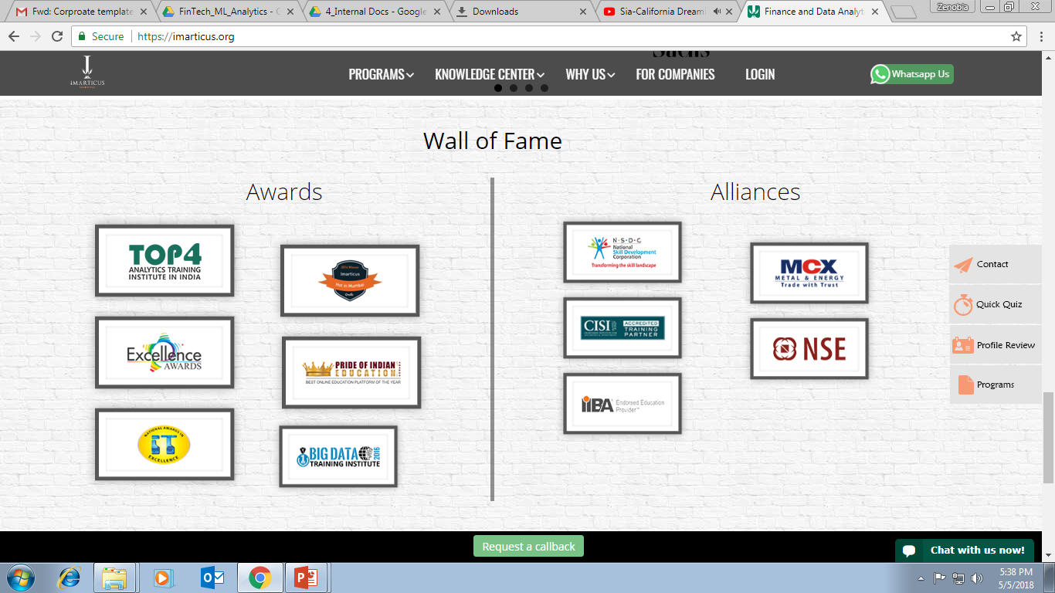



AWARDS:
Learn more:
https://imarticus.org/corporate/
Email us:
info@imarticus.com
Connect with us:
www.linkedin.com/company/imarticuslearning
ACCREDITED TRAINING PARTNER:
Watch us:
www.youtube.com/ImarticusLearninginstitute
Visit us:
Mumbai | Thane | Pune | Bangalore | Delhi - NCR | Hyderabad | Chennai | Coimbatore

